Slide 1
Kickstarter Oracle
Kickstarting your Kickstarter campaign

Slide 2
Content
Market reminder | Meet Kickstarter Oracle | Data Methodology | Prediction models | Insight | Implication

Slide 3

68%
$4.6B
Overall funding in years 2009-2018
a global crowdfunding platform where “creators” can run “campaigns” for people to fund and “back” their project
Unsuccessful campaigns in years 2009-2018

Slide 4
Market reminder #1
The most popular segments are not necessarily
the most profitable

Slide 5
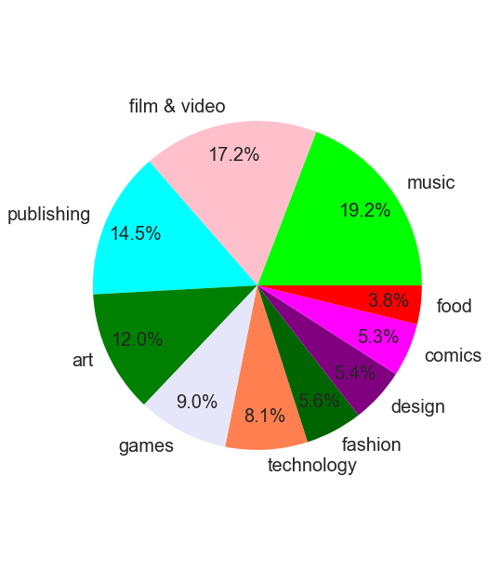
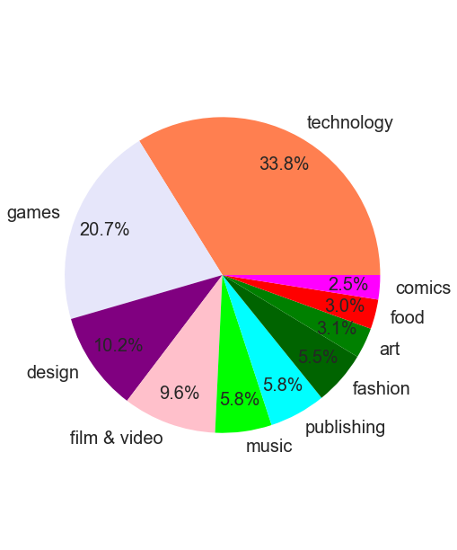
Campaign Segmentation
Money Raised

Slide 6
Market Reminder #2
High Goal==Bad Odds

Slide 7
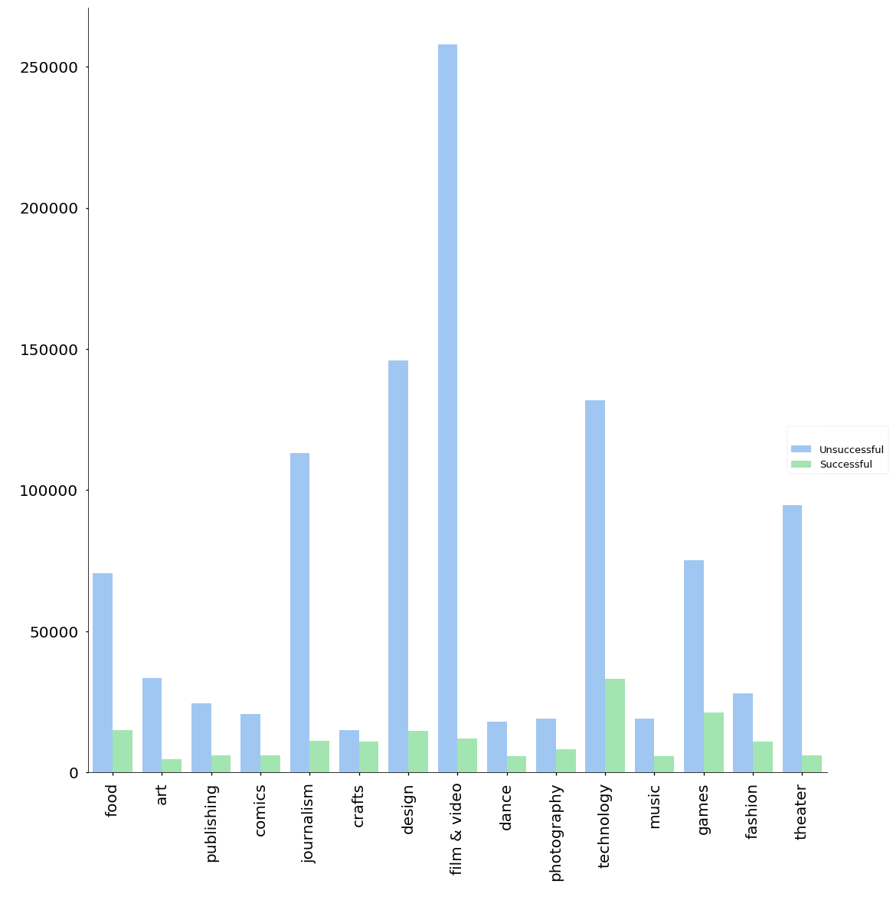
Campaign goal
Goal
Category

Slide 8
Market reminder #3
Once you reach your goal- the funds increase

Slide 9
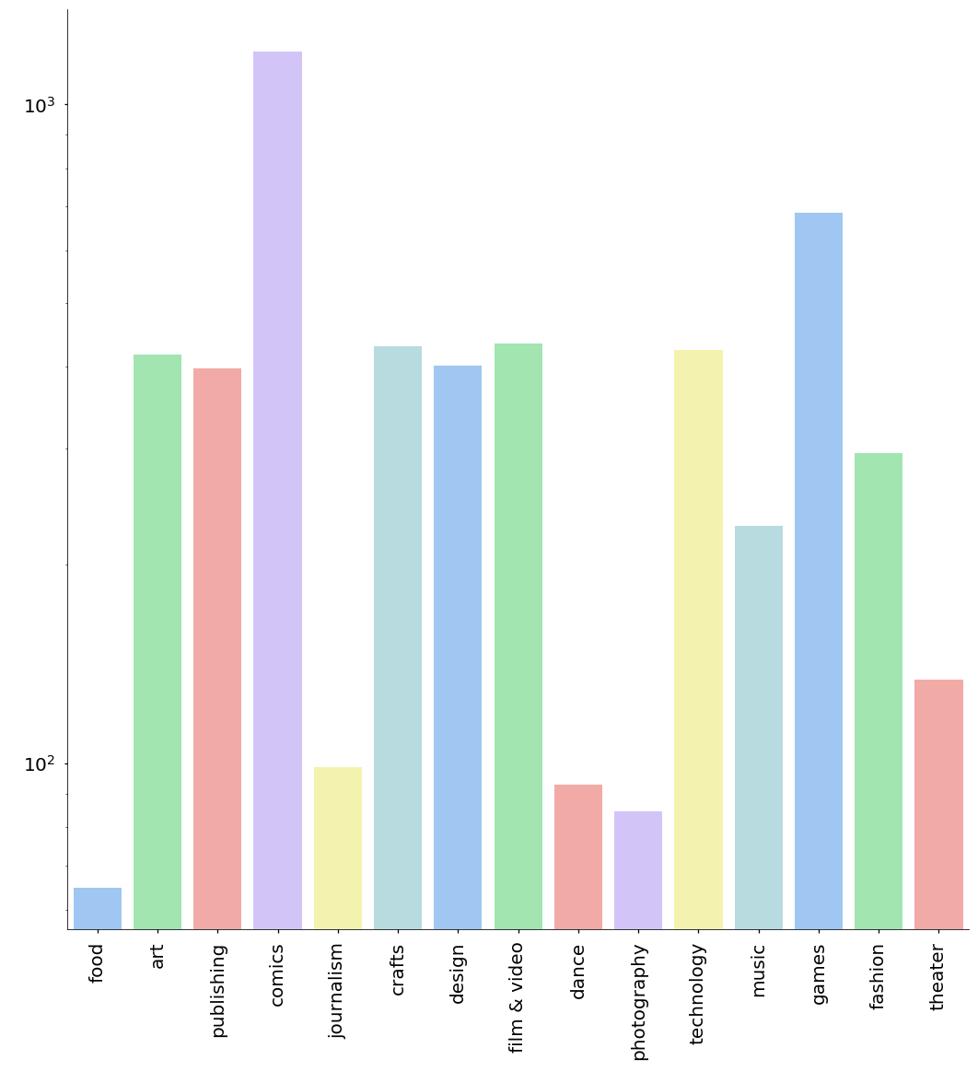
Successful campaigns pledged percent
pledged percent
Category

Slide 10
Meet Kickstarter Oracle

Slide 11
Our Goals
Understand the marketplace
Provide insight into what attributes would make a successful campaign
Tailor the funding goal per campaign specifics.

Slide 12
Data Methodology

Slide 13
Kickstarter Campaigns
300K+
Existing Data:
Campaign name and blurb (description)
Funding goal, number of backers and amount pledged
State: successful, failed, cancelled, or live
Time of creation, launch and deadline
Country and currency
Category
Extracted Data:
Day of week and hour of day for creation, launch and deadline
Time delta
Pledged percent
Text info
Number of existing or recent campaigns in the category

Slide 14

Some new Insights from our data

Slide 15
Text analysis

Slide 16
Text parameters (mean)
Name length
Name is a question?
Name is an exclamation?
Name letters are upper?
How many symbols in the name?
How many words are in the name?
The name vowel to word ratio
How many words are in the product description?
The product description vowel to word ratio
How many symbols in the product description?
35
0.003
0.08
0.03
6.2
5.8
0.3
19
19
22

Slide 17
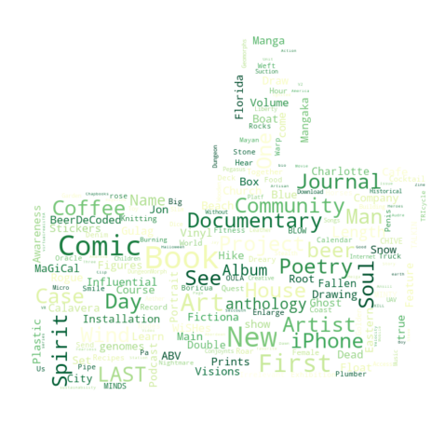
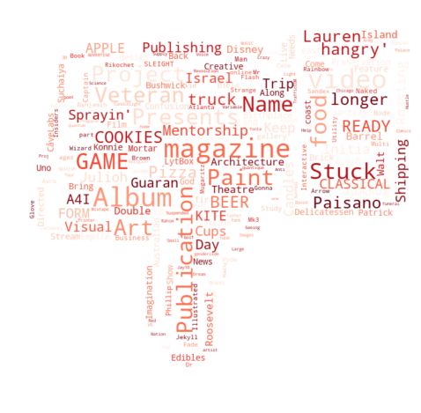
Campaign “BuzzWords’’

Slide 18
Prediction models

Slide 19
Categorical prediction
Decision Tree Classifier | Random forest | GBM

Slide 20
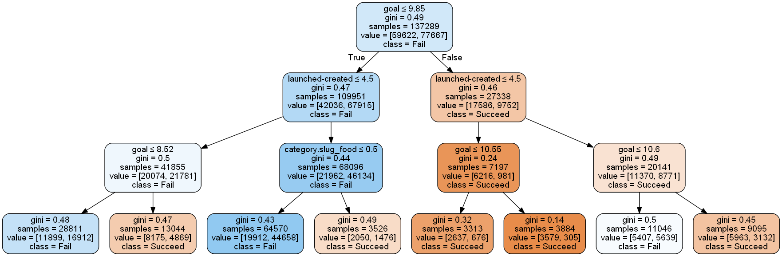
Campaign “BuzzWords’’

Slide 21
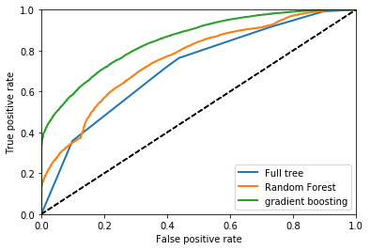
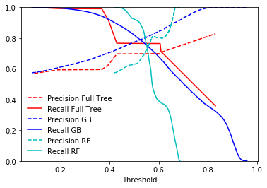
ROC | Precision
Decision Tree Classifier
Precision: 0.85
Recall:0.75
Random forest (RF) Precision:0.83
Recall:0.6
GBM
Precision:0.9
Recall:0.6

Slide 22
Regression prediction
Linear
Polynomial

Slide 23
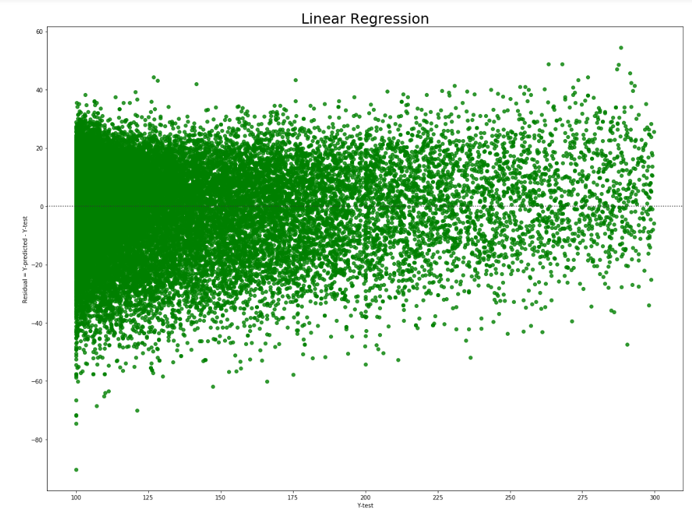
Linear Regression
R²=0.12

Slide 24
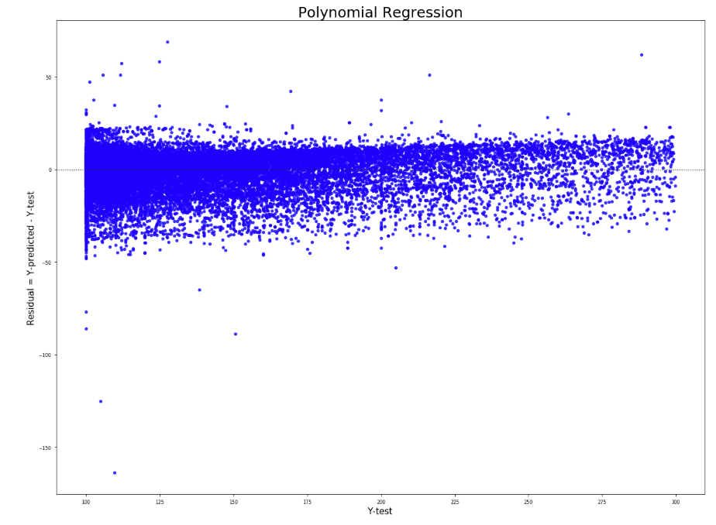
Polynomial Regression
Polynomial degree=5
R²=0.05
Conclusion:
The data is not a good fit for regression methods.

Slide 25
Insights for success
tell me something i don’t know

Slide 27
The Implications

Slide 29
Thank You

